Slide 1

Bank marketing (campaign)
Presented to ABC bank
Group name: Fleifel-solo
Name: Rania Tarek Fleifel
Email: raniatarekfleifel@gmail.com
Country: Egypt, College: Cairo university Faculty of engineering
Specialization: Data science
Internship Batch: LISUM13: 30
Submission date: 14th December 2022
Github repo: https://github.com/RaniaFleifel/Data-glacier-internship/tree/main/Data%20science%20project_Bank%20Marketing%20Campaign/week11

Slide 2
Bank marketing (campaign)
Business Problem:
The ultimate goal of the partnership with ABC bank is to develop a predictive model that enables the bank to target costumers who’re more probable to invest in their new term deposit product.
Objective :
Translate data into insights to help ABC markting team target costumers who are most probable to invest in the new deposit product. This presentation aims to show the exploratory data analysis efforts done on the data to detangle how different information relate. This information will help ABC bank tailor the product to their target audience.
Tenor, interest rate and payment frequency terms of the product can be tuned according to a costumer’s personal and social standing.
Exploratory analysis steps:
Data preparation and wrangling
Data Analysis
Proposed modeling technique

Slide 3
Data preparation and wrangling
Features’ properties & extreme values analysis
Missing values handling
Data Cleaning & feature engineering
Data description after processing & Assumptions
31 Features
Total data points :45206
16 available features
New features
Timeframe of the data: May 2008 to November 2010
Data Assumptions:
Data provided is correct, there’s no wrong reporting of data .
The data spans all year including weekends and holidays.
Means of communication, other than phone and mobile, are not considered.
For Features with “unknown”/missing data , regardless how they’re handled, induce a binary indicator to indicate whether this data was present or not.

Slide 4
Data Analysis
Features
Personal info
age, age_grp
job
Current campaign contact
campaign
marital
Economic & social indicators
Previous contact
previous
poutcome
euribor3m
cosum_price_rates
cosum_conf_index
education
Financial standing
balance
housing
default
overdraft
loan
month
day, day_of_week
contact
year
duration
unemployed_rate
rec

Slide 5
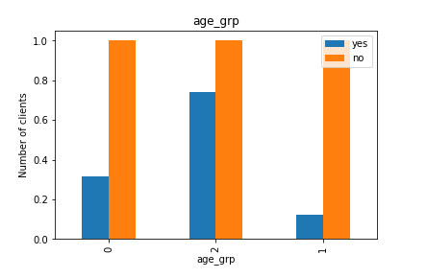
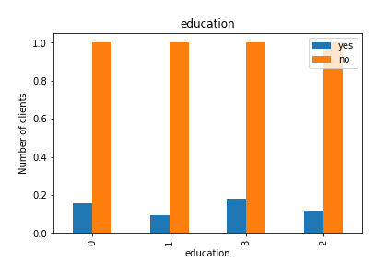
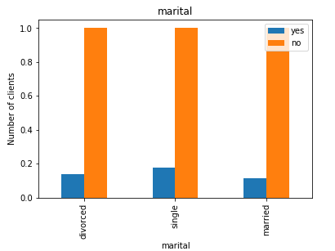
Personal info & financial standing: Who to target ?
Distribution of features
age [18, 95]
age_grp {0,1,2}
0: young <25
1: adult [25,65]
2: elderly >65
Education { 0,1,2,3}
1: primary
2: secondary
3: tertiary
Marital
Divorced
Single
Married
Single adults who have tertiarily education are a good starting point!

Slide 6
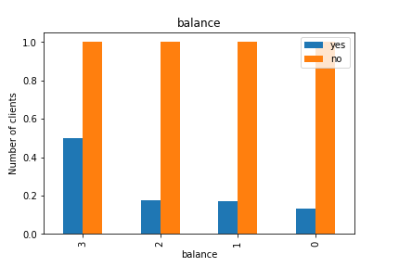
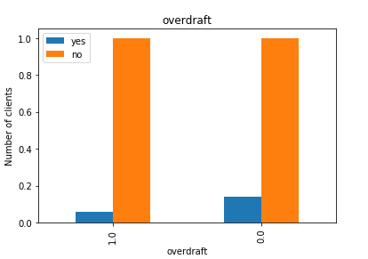
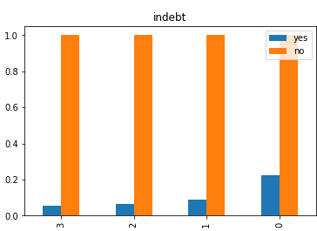
Personal info & financial standing: Who to target ?
Distribution of features
balance {0,1,2,3,4}
- vlow, low, med, high, vhigh
overdraft {0,1}
- 1 if balance<0
indebt: [0,3]
default+housing+loan
default, housing, loan: {0,1}
+
Have high yearly balance, not indebt and with zero overdraft
are a good starting point !

Slide 7

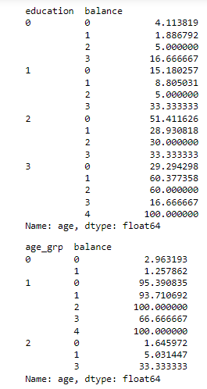
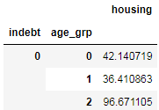
Personal info & financial standing: Insights regarding client’s lifestyle
Elderly people have 0 overdraft
Almost all elderlies (96%) have no debts
No defaults doesn’t necessarily mean no overdrafts
Costumers with 0 debts probably have no defaults
Tertiarily educated adults have the highest balances

Slide 8
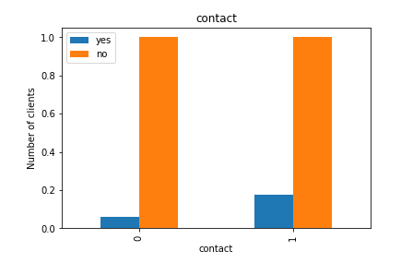
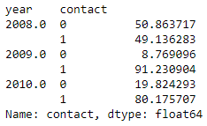
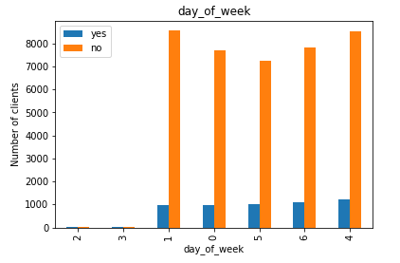
Current campaign contact: When and how to contact clients?
Cell contact is more effective than telephone and gained more popularity over years
Bank employees focus their calls away from the middle of the week
Distribution of features
year {2008,2009,2010}
contact
0: telephone
1: cellphone
campaign [1:36]
(#of contacts with 1 client)
duration [1:81] (in minutes)
Last contact duration with 1 client
month , day
day_of_week [0:6]
Sunday→Saturday
Rec {0:1}
1 for 2008 and 2009 till June
0 afterwards

Slide 9
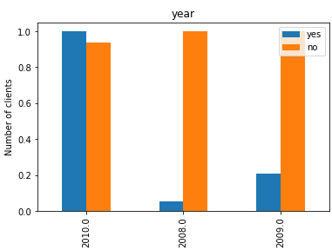

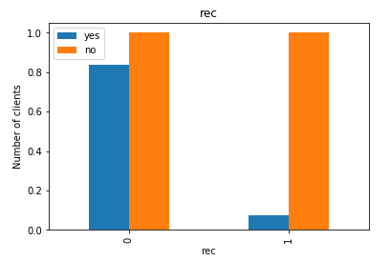
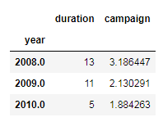
Current campaign contact: Insights regarding factors affecting contact rate
Highest number of contacted costumers is in 2008 (although we have 6 months record only)
And yet, very little people
accepted the product!
The average duration and frequency of calls was highest in 2008
The cause of these results is recession that started in 2008 and ended officially in June 2009

Slide 10
Previous contact with costumers Features’ distribution and dependencies
poutcome {0,1}
Outcome of previous outreach on past campaigns
Previous [0,275]
#of contacts with this costumer before
When no previous contact exist, this means a costumer has not participated in any previous campaigns (poutcome: non-existent)
So the cases for these features are:
previous=0, poutcome=0 → non-existent
previous>0,poutcome= 0 or 1 → no or yes

Slide 11

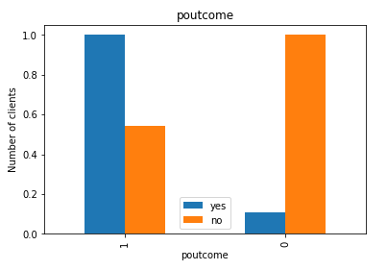
Previous contact with costumers Costumer’s responsiveness to previous contact
Most dominant case in the dataset is the non-existent case
Costumers who have previous contact with the bank are more inclined to say yes to current campaigns

Slide 12
Economic & social indicators What can societal indicators tell us?
Euribor3m: direct driver for setting interest rates on bank products
Cosum_price_rate: reflects inflation
Consum_conf_index: reflects economic growth
Unemployed_rate

Slide 13
Proposed modeling techniques
Techniques
Logistic regression (benchmark of binary classification)
Random forest (resilient to ambiguous values such as “unknown”)
Balanced bagging classifier (re-sampling of majority and minority classes to combat imbalanced datasets)
XGBoost (hyperparameters are tuned to balance-out highly imbalanced datasets)
Performance criterion→ Percision
Accuracy is misleading due to highly imbalanced datasets
The metric is determined by deciding on the most critical type of error, in this project the biggest waste of resources is contacting clients who won’t purchase the deposit product → False positives

Slide 14
Thank You

